Slide 1

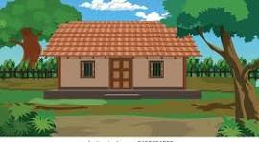
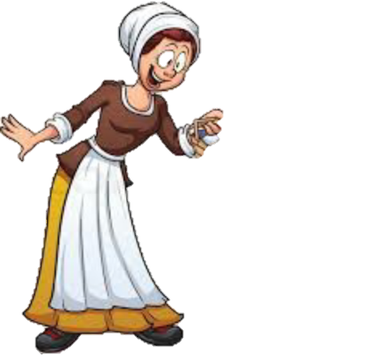

And get it to your grandma
Ok mom

Slide 2
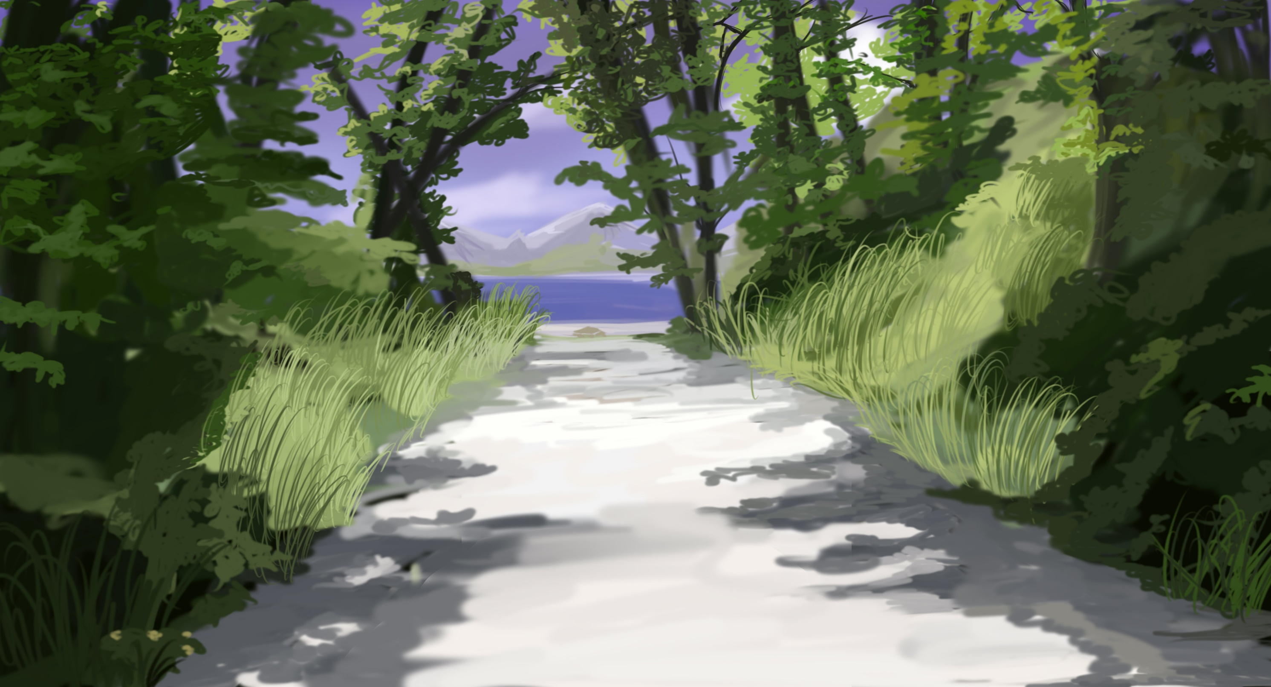
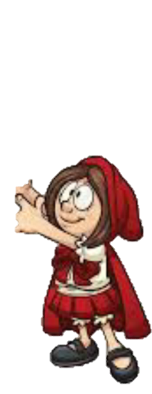
Lalalalalala

Slide 3

Give me that bucket
Go away I am already late

Slide 4
Hey granny!!! I am here

Slide 5
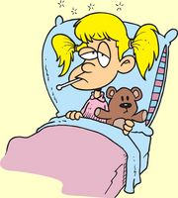
Ohh honey! I was Feeling hungry
Hey I bring you Fruits
Hey Lilly stay away

Slide 6


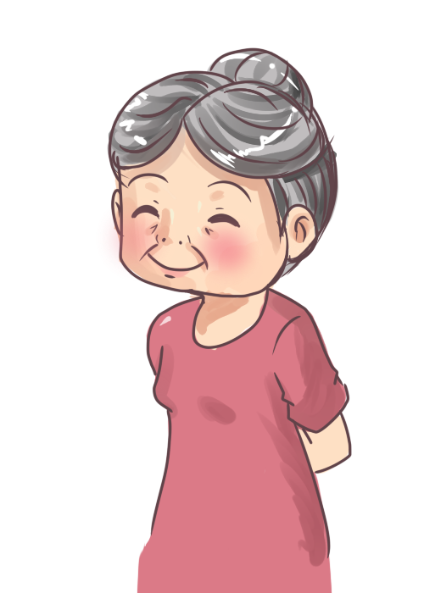
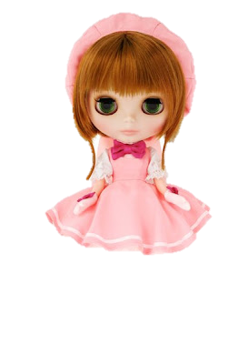
Stay away from my daughter
Help ! Help !

